Slide 1
Introduction to Geographic Information Systems
Yi Qiang （强毅）
Department of Geography
University of Hawaii - Manoa

Slide 2
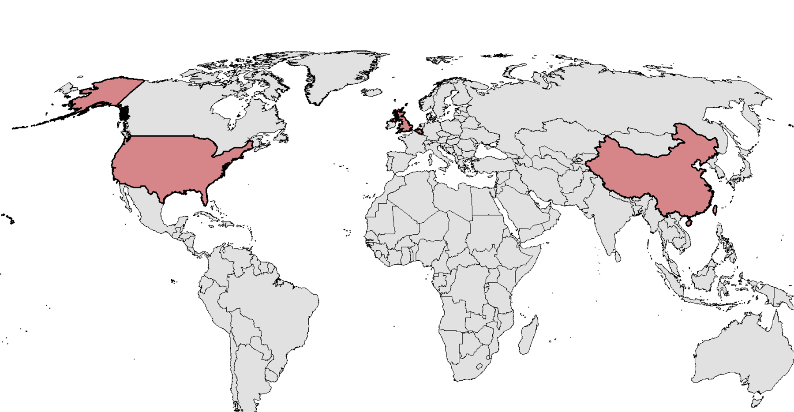

About Me
2017 – Now, Assistant Professor at University of Hawaii
2016 July – Dec, Research Associate at University of Colorado - Boulder
2013-2016, Postdoc at Louisiana State University
2012 Ph.D. in geography, Ghent University, Belgium
2007 M.Sc. in geographical information science, University of Edinburgh, UK
2006 B.Sc. in geographical information systems, Beijing Normal University, China

Slide 3
My Research
Spatio-temporal modeling
Natural Hazard
Geovisualization
GIS
Resilience & Sustainability
Geocomputation
Environment Modeling
Fundamental research
(GIScience)
Practical research
(GISystems)

Slide 4
What is GIS
What is GIS?
Why you want to study GIS?
How do you use GIS in your study/research?

Slide 5
What is GIS
GIS usually stands for Geographic Information Systems
GIS sometimes refers to Geographic Information Science (or GIScience)
GISystem: A computer system that collect, manage, model, and analyze geospatial data to understand relationships, patterns, and trends in the data.
GIScience: the scientific discipline that studies geospatial data structures and computational techniques to capture, model, process, and analyze geographic information.

Slide 6
Where GIS can be applied
Urban and regional planning
Natural resource management
Transportation and logistics analysis
Natural disaster mitigation and adaptation
Emergency management
Terrain analysis
Public health and epidemiology analysis
Millitary
and more…

Slide 7
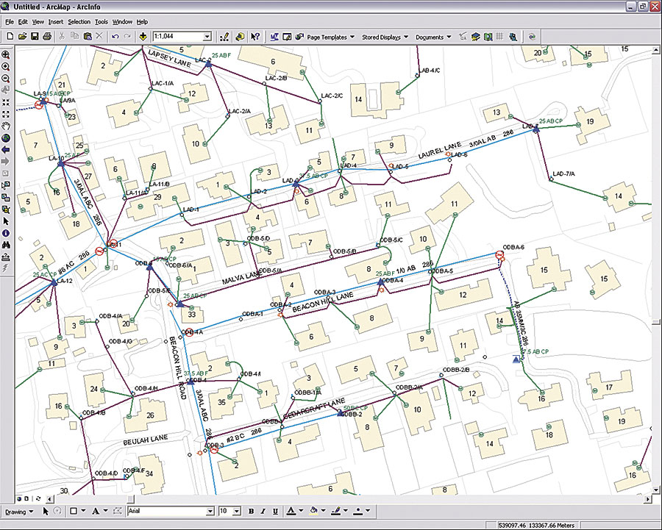
What GIS does? - A Day with GIS
7:00am, my alarm clock goes off… The energy to power the alarm comes from the local energy company, which uses a GIS to manage all its assets (e.g. electrical conductors, devices, and structures) so that it can deliver electricity continuously to customers.

Slide 8
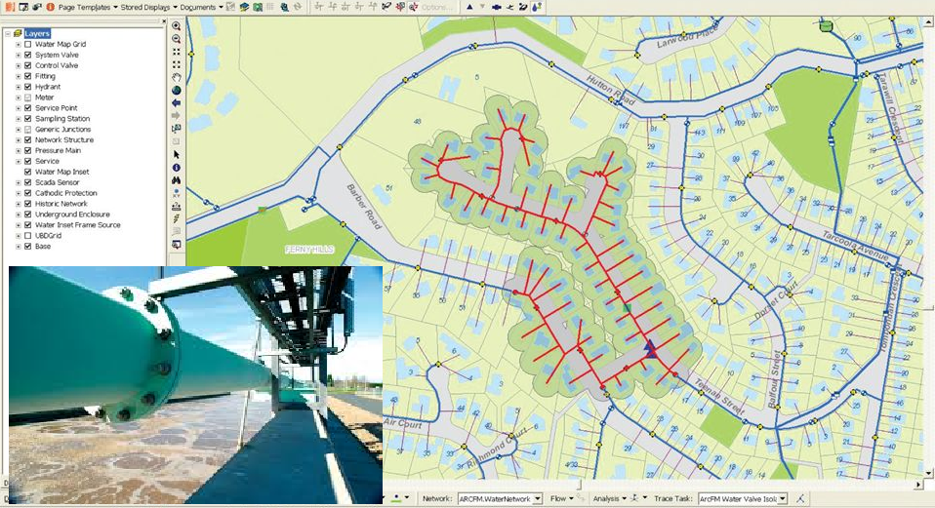
What GIS does? - A Day with GIS
7:15am, I jump in the shower… The water for the shower is provided by the local water company, which uses a hydraulic model linked to its GIS to predict water usage and ensure that water is always available to it customers.

Slide 9
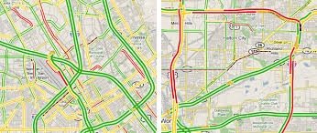
What GIS does? - A Day with GIS
8:00am, I plan my travel to my office… I turn on my smart phone to check the traffic condition on my way to office. It turns out there is a long pipe-up on the highway from my home to office. The GIS in the App suggests that taking a bus is faster than driving.
Real-time traffic in GIS

Slide 10
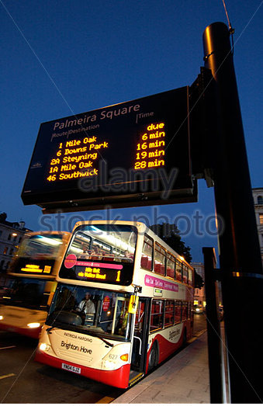
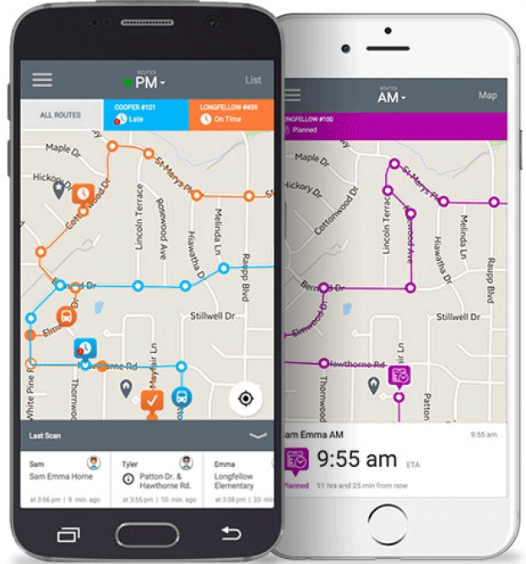
What GIS does? - A Day with GIS
8:15am, I catch the bus… At the station, the waiting times for different buses are displayed in a LED board using the real-time locations from GPS installed in the buses. I can also check this information as well as current locations of buses from an App in my smart phone.
Bus waiting time at bus station
Tracking bus location in a mobile App

Slide 11
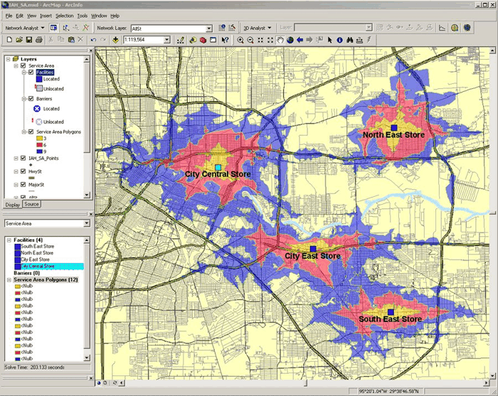

What GIS does? - A Day with GIS
8:45am, I arrived at my office… I work at a grocery company (e.g. Walmart). The manager is call for a meeting to discuss the location of a new branch. We have invited a GIS consultant company to assess the best location of the new store, which will be close to our potential customers and have lowest land price and building cost.
Accessibility to grocery stores

Slide 12
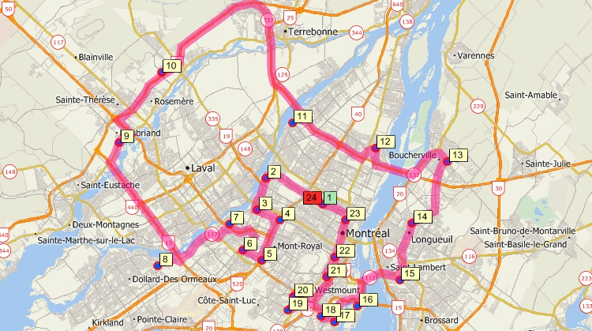
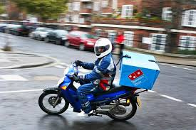
What GIS does? - A Day with GIS
11:45am, I feel hungry… I am ordering my lunch from Domino Pizza. The manager use a GIS to figure out which deliveries should go out together and plan the best delivery route for the delivery staff.
Use GIS to plan delivery route

Slide 13
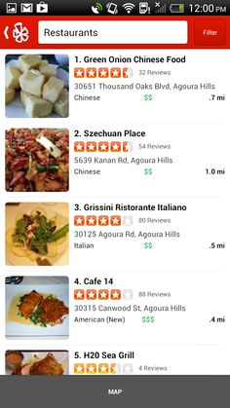
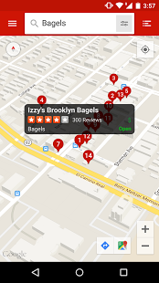
What GIS does? - A Day with GIS
5:00pm, I am off work. I plan to have dinner with some friends at a certain place. I use GIS to search for restaurant near that place and plan my route to the restaurant.
Query for restaurants near a location in GIS
Checking for restaurant reviews contributed by volunteer users

Slide 14
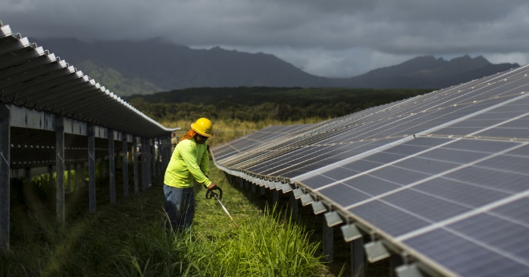
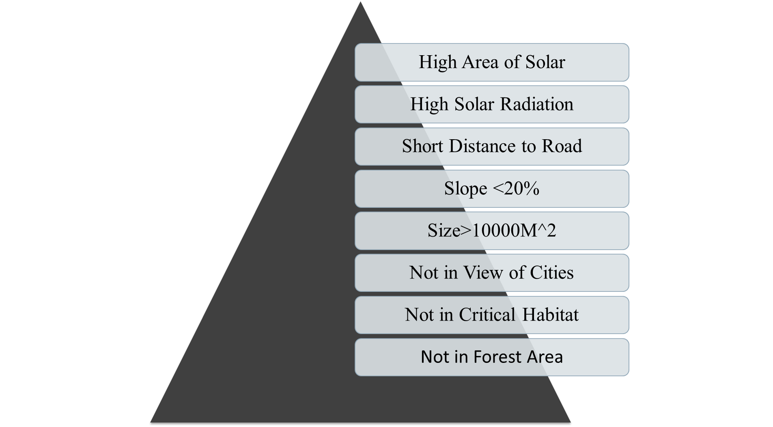
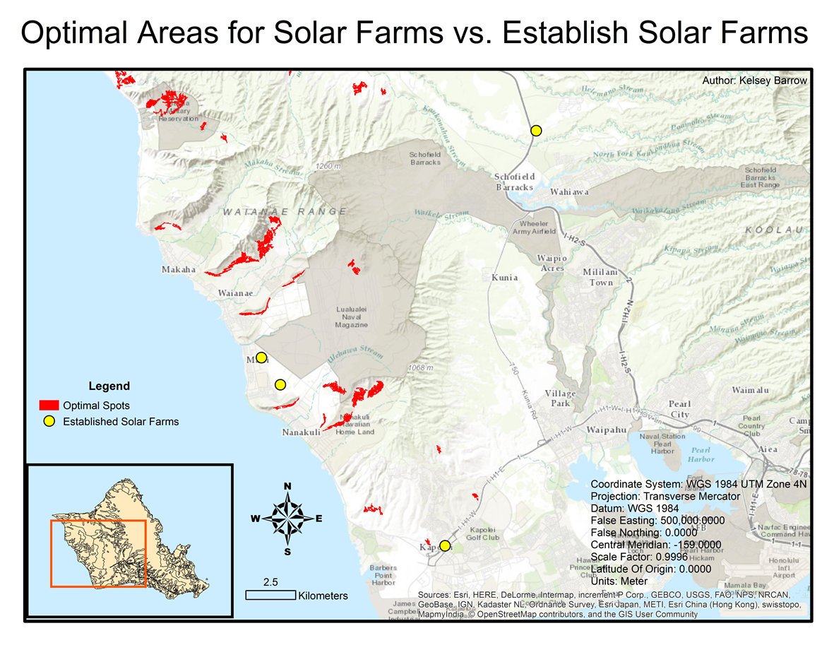
GIS in Planning
Finding suitable locations for different types of development, for instance, solar farm

Slide 15
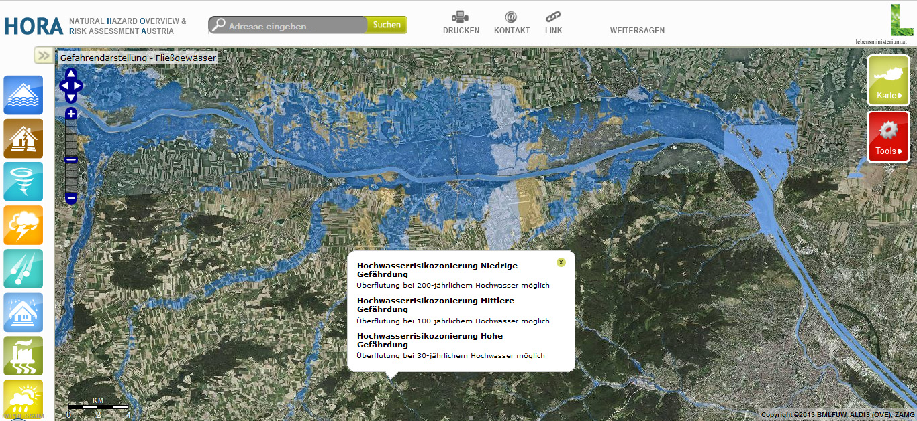
GIS in Hazard Mitigation
Use GIS to assess risk, exposure, and vulnerability to flood, wildfire and sea level rise

Slide 16
GIS in Hazard Mitigation
Use GIS to assess risk, exposure, and vulnerability to flood, wildfire and sea level rise
Precipitation
Slope
Land cover type
Land slide risk

Slide 17
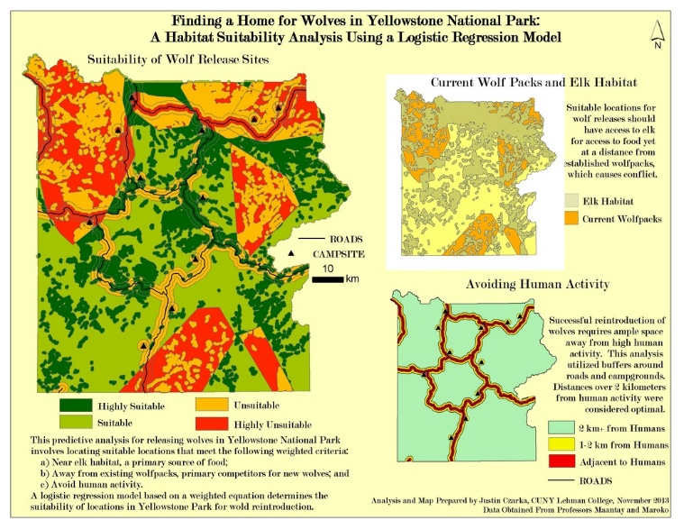
GIS in Environment Conservation
Use GIS to find suitable habitat of certain species – guide delineation of conservation area or wildlife refuges.
EA3692652

Slide 18
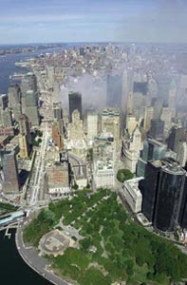
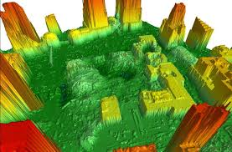
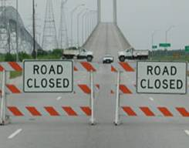
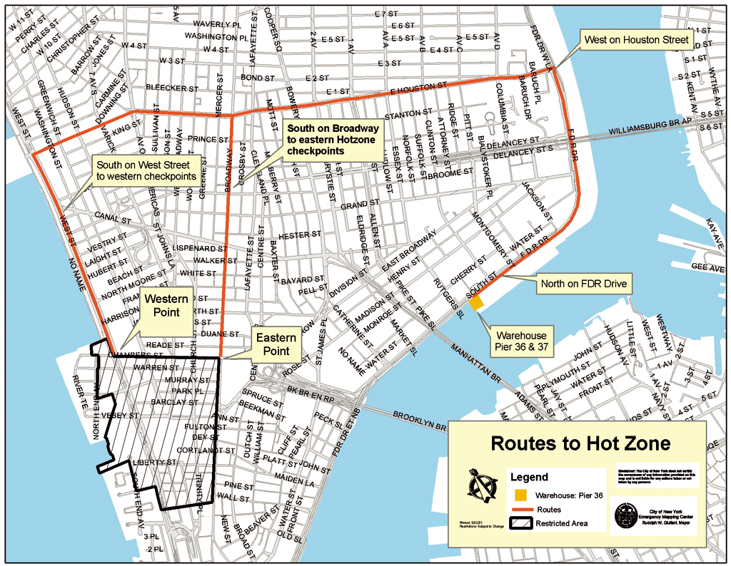

GIS in Emergency Management
Manage and allocate assistance resources to reach the destination efficiently
Delineate functional zones to facilitate evacuation and recovery
DEM post-911
September 11, 2001
The mapping center within the EOC was equipped with 20 GIS workstations and five plotters.

Slide 19
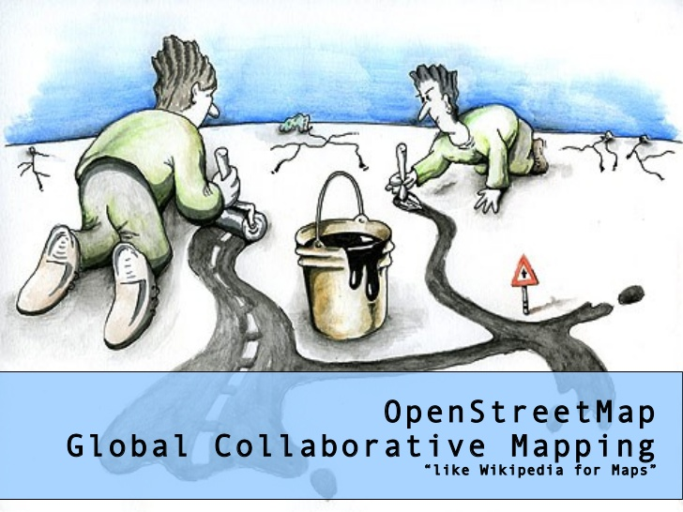
Public Participation GIS and Volunteer GIS
Creating a free editable map of the world by numerous volunteer users. (typical example: OpenStreetMap)
Map data is collected from scratch by volunteers performing systematic ground surveys using tools such as a handheld GPS unit, a notebook, digital camera, or a voice recorder.

Slide 20
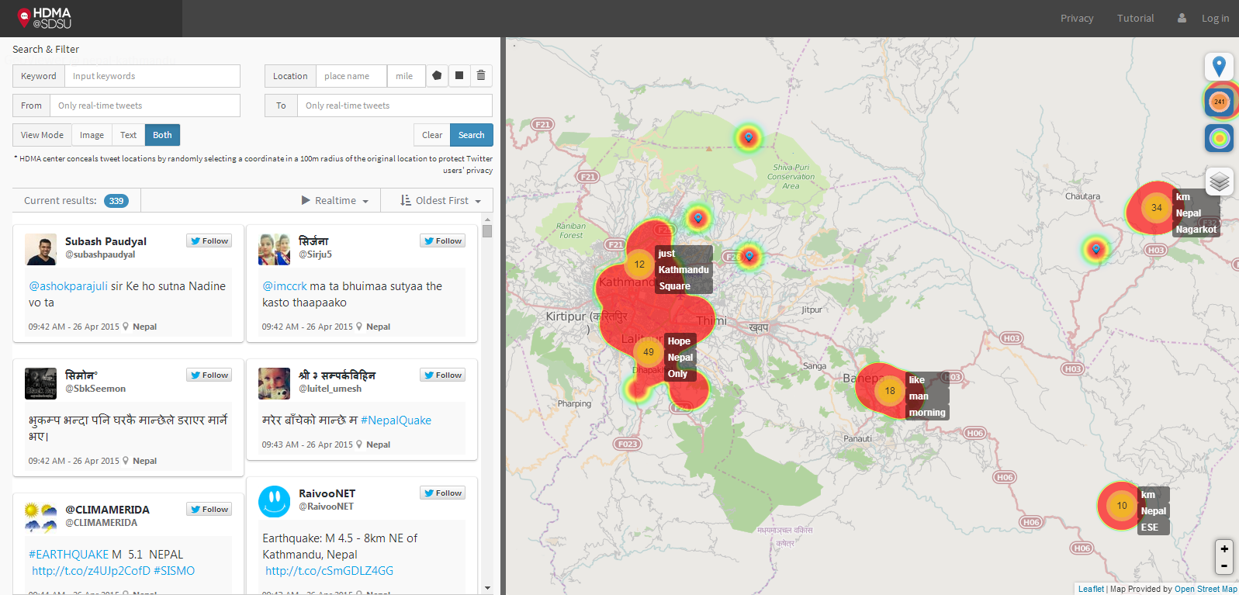
GIS and social media

Slide 21
Applied GIS
Part I: Principles
An Introduction to GIS
Representing the World in GIS
Part II: Techniques
GISystems
Geospatial Data
Geodatabase
Part III: Analysis
Cartography and Map Production
Geovisualization
Spatial Analysis
GIS Modeling
GIS Programming
Part I: Python
Object-oriented programming
Syntax of Python
Python interface and modules in ArcGIS
Part II: GIS Data Access Using Python
Working with vector data
Working with raster data
Part III: Advanced GIS Modelling in Python
Automation of GIS processing tools
Dynamic modeling in GIS

Slide 22
Course Structure
No prerequisite knowledge in GIS or programming
Combination of theories, applications and case studies
Including both lectures and lab exercises
Develop hands-on skills in GIS analysis and modeling
Getting started with Python Programming in GIS

Slide 23
Course Regulation
Do
Ask anytime when you have questions (raise your hands)
Open discussion is encouraged (raise your hands)
Contact me after class
Do not
Be late (>15min late deemed as absence)
Talking out of turn
Use cell phone in class (mute your cell phone)
Other disruptive behavior

Slide 24
My contact information
Email: yiqiang@Hawaii.edu
Website: qiang-yi.github.io
Course materials (lectures and lab exercises):

Slide 25
Topic 1: An Introduction to GIS

